Slide 1
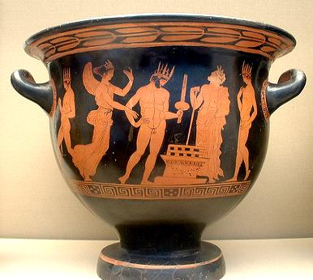
Sampling Error think of sampling as benefiting from room for movement

Slide 2
Sampling Error think of sampling as benefiting from room for movement

Slide 3
Population
µ
Sample
X
_
_
The population mean is µ. The sample mean is X.

Slide 4
Population
µ
σ
Sample
X
_
s
_
The population mean is µ. The sample mean is X.
The population standard deviation is σ, the sample sd is s.

Slide 5
Sample_{C}
X_{C}
_
Sample_{D}
X_{D}
_
Population
Sample_{B}
X_{B}
µ
_
Sample_{E}
X_{E}
Sample_{A}
X_{A}
_
_
In reality, the sample mean is just one of many possible sample
means drawn from the population, and is rarely equal to µ.

Slide 6
Sample_{C}
X_{C}
_
Sample_{D}
X_{D}
s_{c}
_
s_{d}
Population
Sample_{B}
X_{B}
µ
σ
_
s_{b}
Sample_{E}
X_{E}
Sample_{A}
X_{A}
_
_
s_{e}
s_{a}
In reality, the sample mean is just one of many possible sample
means drawn from the population, and is rarely equal to µ.

Slide 7
Sampling error = Statistic - Parameter
_
Sampling error for the mean = X - µ
Sampling error for the standard deviation = s - σ

Slide 8
Unbiased and Biased Estimates
An unbiased estimate is one for which the mean sampling
error is 0. An unbiased statistic tends to be neither larger
nor smaller, on the average, than the parameter it estimates.
The mean X is an unbiased estimate of µ.
The estimates for the variance s² and standard deviation s
have denominators of N-1 (rather than N) in order to be
unbiased.
_

Slide 9
SS
σ²
=
N

Slide 10
SS
s²
=
(N - 1)

Slide 11
SS
s
=
(N - 1)

Slide 12
Correlations describe co-variation on two variables.

Slide 13
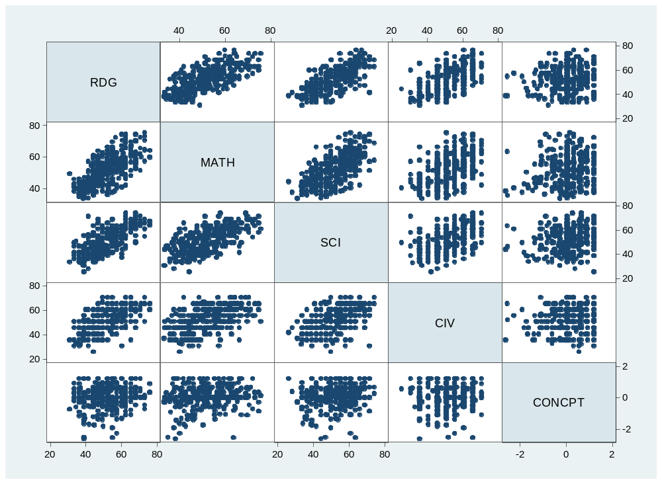
What’s the correlation?

Slide 14
What’s the correlation?

Slide 15
What’s the correlation?
.69

Slide 16
What’s the correlation?

Slide 17
What’s the correlation?
.68

Slide 18
What’s the correlation?

Slide 19
What’s the correlation?
.60

Slide 20
What’s the correlation?

Slide 21
What’s the correlation?
.13

Slide 22
What’s the correlation?

Slide 23
What’s the correlation?
.65

Slide 24
What’s the correlation?

Slide 25
What’s the correlation?
.51

Slide 26
What’s the correlation?

Slide 27
What’s the correlation?
.16

Slide 28
What’s the correlation?

Slide 29
What’s the correlation?
.51

Slide 30
What’s the correlation?

Slide 31
What’s the correlation?
.15

Slide 32
What’s the correlation?

Slide 33
What’s the correlation?
.06

Slide 34
Rounded, the mean reading score is 52 and sd=10 and the mean math score is also 52 and sd=10. If a given student’s reading score is 67, then what is your best estimate of her math score?
.69

Slide 35
In predicting someone’s math score, if you could have just one piece of information, and it is either (a) her reading score, or (b) her self concept score, which would you rather have? What’s it worth to you?
.69
.16

Slide 36
Explain to a non-statistician what it means to say “reading and math scores are correlated r=.69 in this population”.
.69

Slide 37
A key to understanding r
z_{y} = z_{x}
When X and Y are perfectly correlated

Slide 38
We can say that z_{x} perfectly predicts z_{y}
z_{y}’ = z_{x}
_{Or}
z_{y} = z_{x}
^

Slide 39
When they are imperfectly correlated, i.e., r_{xy} ≠ 1 or -1
z_{y}’ = r_{xy}z_{x}
r is the slope of the predicted line, with a zero-intercept of z’_{y}=0

Slide 40
Explain to a non-statistician what it means to say “reading and math scores are correlated r=.69 in this population”.

